Slide 1
Team VESSEL
Vascular ElectroSpun Silk Engineered Linings
“We pledge on our honor that we have not given or received any unauthorized assistance on this assignment”
Gemstone Junior Colloquia Presentation
19th November 2015
M. Al-Salihi, A. Berger, M. Dang, I. Jones, M. Karsalia, C. Lim, S. Menachery, G. Mgboji, A. Nou, M. Singleterry, D. Srinivasan, P. Tran, A. Zhou
Mentor: Dr. Adam Hsieh
Librarian: Eileen Harrington
Notes:
Welcome to Team VESSEL’s Junior Colloquia defense, my name is ……. and today we will be discussing with you our project and the product we want to produce to assist in bypass surgeries
Mentor
Librarian

Slide 2
Outline
Research Problem
Methodology
Preliminary Results
Goals of Research
Challenges
Advice for Freshmen
Notes:
Before we get into the details of our project, I’d like to first give you all a brief outline of what we will be discussing today:
Me -> talking about the problem that we wish to solve, vascular disease, and then explaining current research done in the field today
Phillip -> explain our research question, and then describe the methodology of creating our product and modifying it
Moli -> will finish our presentation by explaining how we’ll test our product, and go into our possible future directions, timeline, and budget

Slide 3

Notes:
But first….a video
*Make sure this video works when opened*

Slide 4
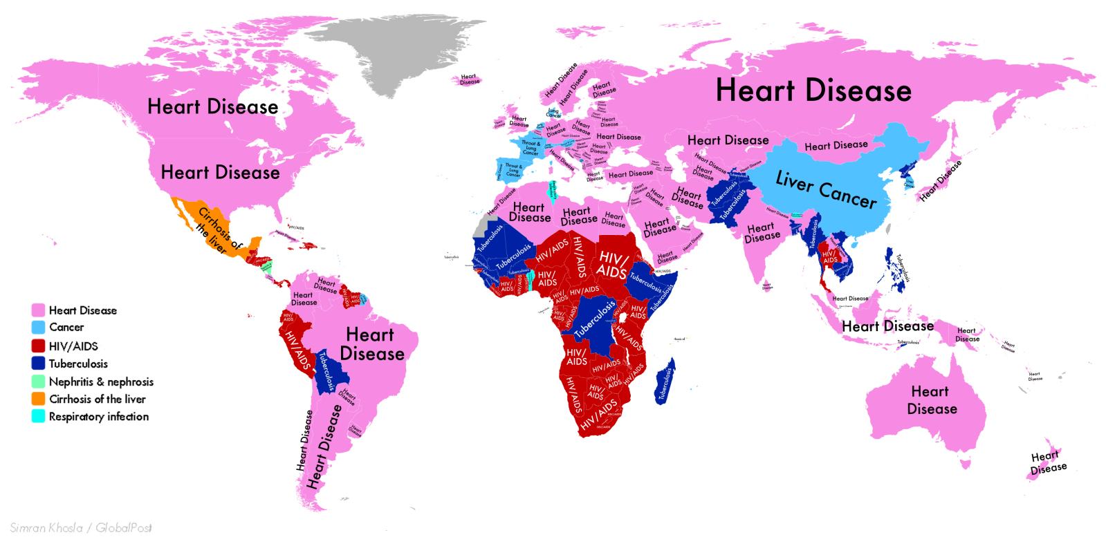
Cardiovascular Disease
http://www.huffingtonpost.de/2014/09/17/krankheiten-_n_5834018.html
Notes:
The Problem with Cardiovascular Disease
Leading cause of death (Sell, McClure, Garg, Wolfe, & Bowlin, 2009)
One in three Americans have a form of cardiovascular disease (Lloyd-Jones et al., 2010)
Some types
Septicemia, congestive heart failure, cardiac arrhythmia, acute myocardial infarction, acute cerebrovascular diseases are top 15 reasons for hospital visits (“Rank order of CSS principal diagnosis category by number of discharges,” 2012) - five of the top fifteen reasons for hospital visits are related cardiovascular disease
Specifically Team VESSEL will be focusing on peripheral arterial disease.
**atherosclerosis- plaque build-up, can lead to heart attack, stroke, kidney failure, infection and other vascular diseases
congestive heart failure - heart is too weak to pump blood throughout body, causes fluids to build up in organs
acute myocardial infarction (heart attack)
Actual last resort - Transmyocardial Laser Revascularization (TMLR)
Where lasers punch holes into muscle to allow blood to reach the heart for oxygen - specifically for Angina
When many bypass surgeries have been done, and no more can be performed on the body

Slide 5
Peripheral Artery Disease
Treatments
  Diet
  Exercise
  Medication
Arterial bypass surgery
  Commonly performed in Europe and US
  Uses vascular grafts to redirect blood flow
  Shown to decrease mortality
  Clinical need for small diameter vascular grafts
Notes:
Peripheral arterial disease is when the arteries, from the extremities, become narrow and harden up. Plaque builds up along the walls of the arteries and as a result, blood decreases, which could lead to nerve and tissue damage.
Typical treatments include:
Diet and exercise
Medication
Arterial bypass surgery
The solution for the more serious cases (if diet and exercise don’t work)
Arterial bypass surgery (coronary and peripheral)
Bypass is only used for serious issues
One of the most common heart surgeries in the US and Europe, with over 1 million procedures performed across both each year (Vara et al., 2005).
Define - uses vascular grafts to redirect the blood flow away from problem areas of clogging and disease
Proven to decrease the mortality rate for patients (Jeremias, Kaul, Rosengart, Gruberg, & Brown, 2009)
Methods
Commonly performed with autologous grafts (Liu et al., 2013; Foster & Kranc, 1989) -- explain why this is not always an option
Prosthetic grafts another option

Slide 6
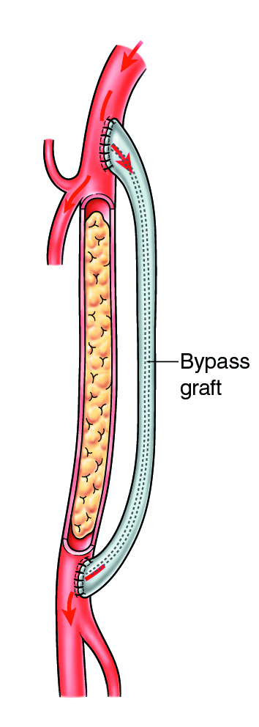
Vascular Grafts
Purpose
Mimics a native blood vessel
Scaffold for new tissue growth
Current State
Autologous grafts: most preferred, although not always available
Engineered grafts: another option, but not available for small diameter vessels
http://bathvascular.co.uk/arterial-work/peripheral-vascular-treatment/
Notes:
Purpose
Acts as an alternative path for blood flow to bypass problematic areas in the patient’s circulatory system
For future use, the graft act as a scaffold for new cells and tissue to grow, to allow a new native vessel to form
Currently
Define autologous grafts
Explain why not available (old people, tissue is not of great quality or has already been used, transplants are not immediately available)
Define synthetic grafts
Have been successful for larger diameter grafts, but
A successful synthetic small diameter graft (<6mm) has not been created
Problems with small diameter in general
occlusion (closing of blood vessel), thrombogenesis (clots forming that break off and block another vessel), mechanical compliance
DEFINE PATENCY

Slide 7
Synthetic Grafts
Problems:
    Occlusion
    Thrombogenesis
Prevalent in small-diameter vessels
Solution: Develop small-diameter graft to
  Increase biocompatibility
  Correct for mechanical shortcomings
Notes:
team: check this slide

Slide 8
The Ideal Graft
No adverse response from the patient
Mimics properties of native blood vessel
Facilitate and support the growth of new tissue
Pliable and easy to suture by surgeons
Notes:
Does not cause adverse response (biocompatibility, thrombogenicity, infection resistance)
Properties of native blood vessel ( promotes cell growth, compliance, elasticity, matrix, porosity)
Resistant to clotting, and blockage
RECRUITS CELLS TO FOSTER NEW TISSUE GROWTH

Slide 9
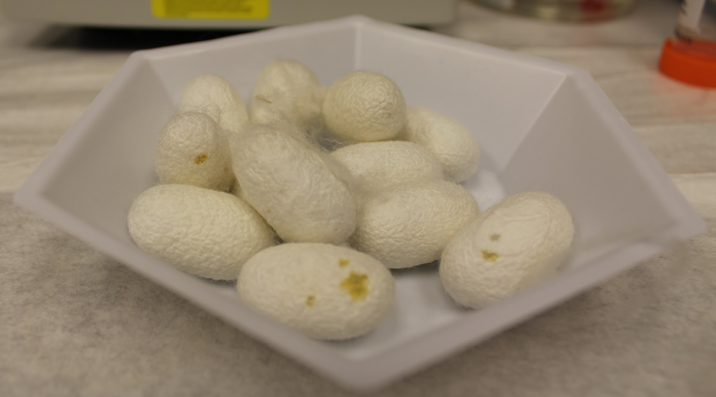
Silk
Produced by Bombyx mori, the silkworm
Advantageous properties:
  Abundant
  Strong
  Biocompatible
Lovett et al.
  Proved that silk has appropriate properties to be used in vascular grafts
Notes:
Silk - which is the material we wish to use for our product
Comes from the Bombyx mori, or the silkworm
Biosynthesized during the late larval stages of growth in the silk glands
SF is best suited for tissue engineering applications due to its ready abundance, advantageous structural properties, and biocompatibility, which likely stem from the chemical structure.
Has been used in the medical field for centuries, dating back to being used as sutures
Study by Lovett et al., from 2007
silk-based small diameter vascular grafts were developed and tested to determine whether silk was a viable option for grafst
These grafts were tested numerous ways
Pore size, burst strength, enzymatic degradation, and cell migration
Proved that silk had the mechanical/biocompatible properties to be used in vascular grafts
Acted as foundation for perfecting SF grafts, through manufacturing and biochemical tailoring
silk fibroin has shown promise to create small diameter vascular grafts (bc mechanical properties), PRELIMINARY

Slide 10
Research Question
How can a basic, small-diameter, electrospun silk fibroin vascular graft be biochemically modified to improve the graft’s overall patency?
Notes:
Research questions=purpose
VEGF vascular endothelial growth factor
fibrin, elastin, heparin
mechanical compliance- elasticity
matrigel
Read research question.

Slide 11
Hypothesis & Project Aims
Hypothesis: Adding coatings and growth factors to the vascular grafts will
(1) improve mechanical properties
(2) encourage the recruitment of HUVECs
Project Aims:
  Improve cell adhesion to and proliferation within graft
  Enhance mechanical properties of graft
Notes:
Read hypothesis. Read project aims. This is different from previous studies conducted on vascular grafts because we are looking to improve the graft through a variety of modifications that have not been tried before, especially with growth factors, which I will talk about later on.
matrigel
End of section 1: Amy (slides 1-10)

Slide 12
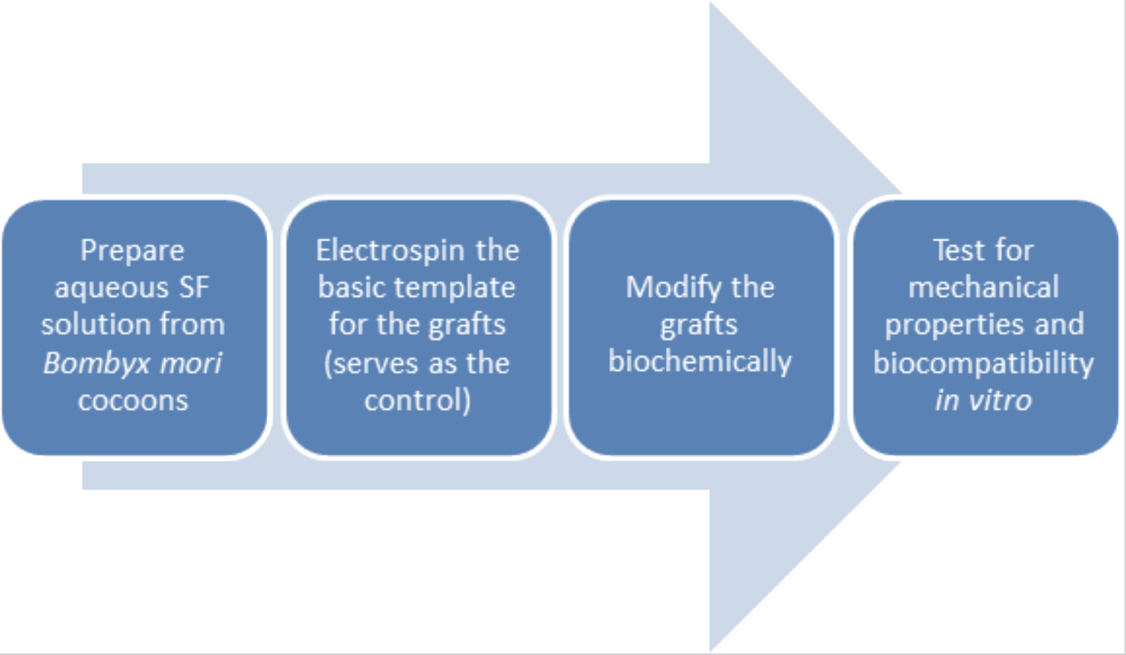
Methodology Overview
Notes:
Section 2: Methodology (Mina) (slides 11-20)
Irene
In order to test our hypothesis, we’ll follow this flow chart starting with creating an aqueous silk fibroin solution from the cocoons of silk worms, then we’ll make sure we can make the graft consistently which will be used as our control then we’ll modify the graft with coatings and growth factors. Next we’ll compare these grafts against the control grafts to see how they withstand mechanical testing and biocompatibility.
As can be seen from the figure, our methodology will follow a procedural flow. We will complete each phase before we can move on to the next, allowing for full assurance of a quality product at the end of each step. Phase one of the research will be to extract the SF from B. mori cocoons, turn it into an aqueous solution, and electrospin the basic graft construct. Phase two will involve taking some of the control grafts and biochemically modifying them with growth factors and coatings. Phase three will involve testing the biochemically modified grafts to their control graft counterparts in order to look for improved mechanical strength and biocompatibility in the latter. Statistical analysis will be performed to decide if any improvements are significant.

Slide 13
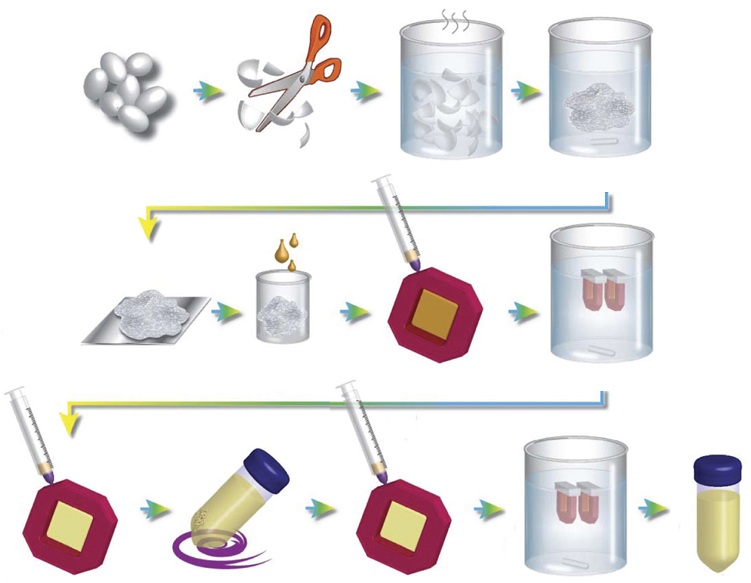
Silk Preparation
Adapted from Rockwood et al, 2011
Notes:
Bombyx mori silk cocoons
Cut cocoons and dispose of worms
Boil cocoons in sodium carbonate to remove sericin (SF insoluble in salt solution)
Rinse fibers in DI water
Left fibers to dry over night
Incubated fibers with 9.3M Lithium Bromide
Add silk LiBr solution to dialysis cassettes
Dialyze silk LiBr solution
Remove silk fibroin
Centrifuge SF
Add SF to dialysis cassettes
Concentrate in PEG
Remove concentrated SF and store
Irene
silk has been used in the past and has shown success with mechanical testing, it also allows for a graft of a smaller diameter to be created.
there are two proteins in cocoons: Silk Fibroin and sericin
we’ll extract silk fibroin from silk worm cocoons by boiling the cocoons in a salt solution which separates silk fibroin from the sericin based on solubility and then getting rid of the sericin
As we mentioned before, silk fibroin has been selected because of its abundance and excellent properties. In order to obtain the SF from raw silk, we must use a series of degumming processes. First, we will remove the sericin from the cocoons. To do this, the cocoons are cut open and boiled in a solution of sodium carbonate. After removing the sericin protein, we will dissolve, purify, and dilute the SF to obtain a 6-8% w/v solution. To accomplish this, the fibers will be rinsed with diluted water, excess water removed, and left to dry overnight. Then, lithium bromide will be placed atop the fibers and the solution will be incubated. After this, we will perform dialysis against ultrapure water. Finally, we will centrifuge the silk down, where it will be ready to be stored at 4 degrees Celsius for up to one month.
boiled for 30 minutes in 0.02 M sodium carbonate
the fibers will rinsed with diluted water for 20 minutes 3 times, excess water removed, and left to dry overnight
9.3 M lithium bromide will be placed atop the fibers and the solution will incubated at 60 degrees Celsius for 4 hours
After this, we will perform dialysis against ultrapure water for 72 hours.

Slide 14
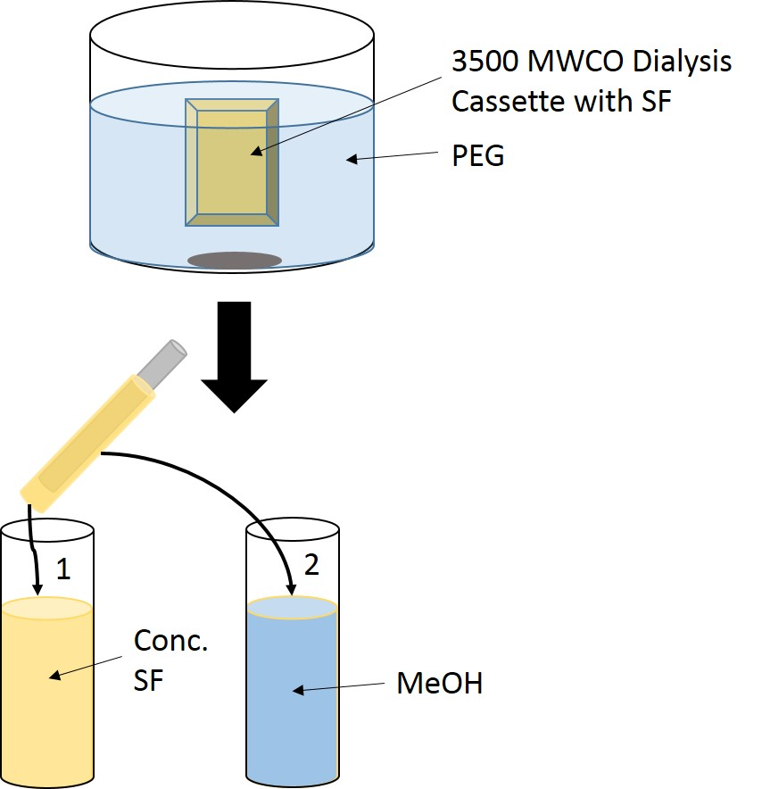
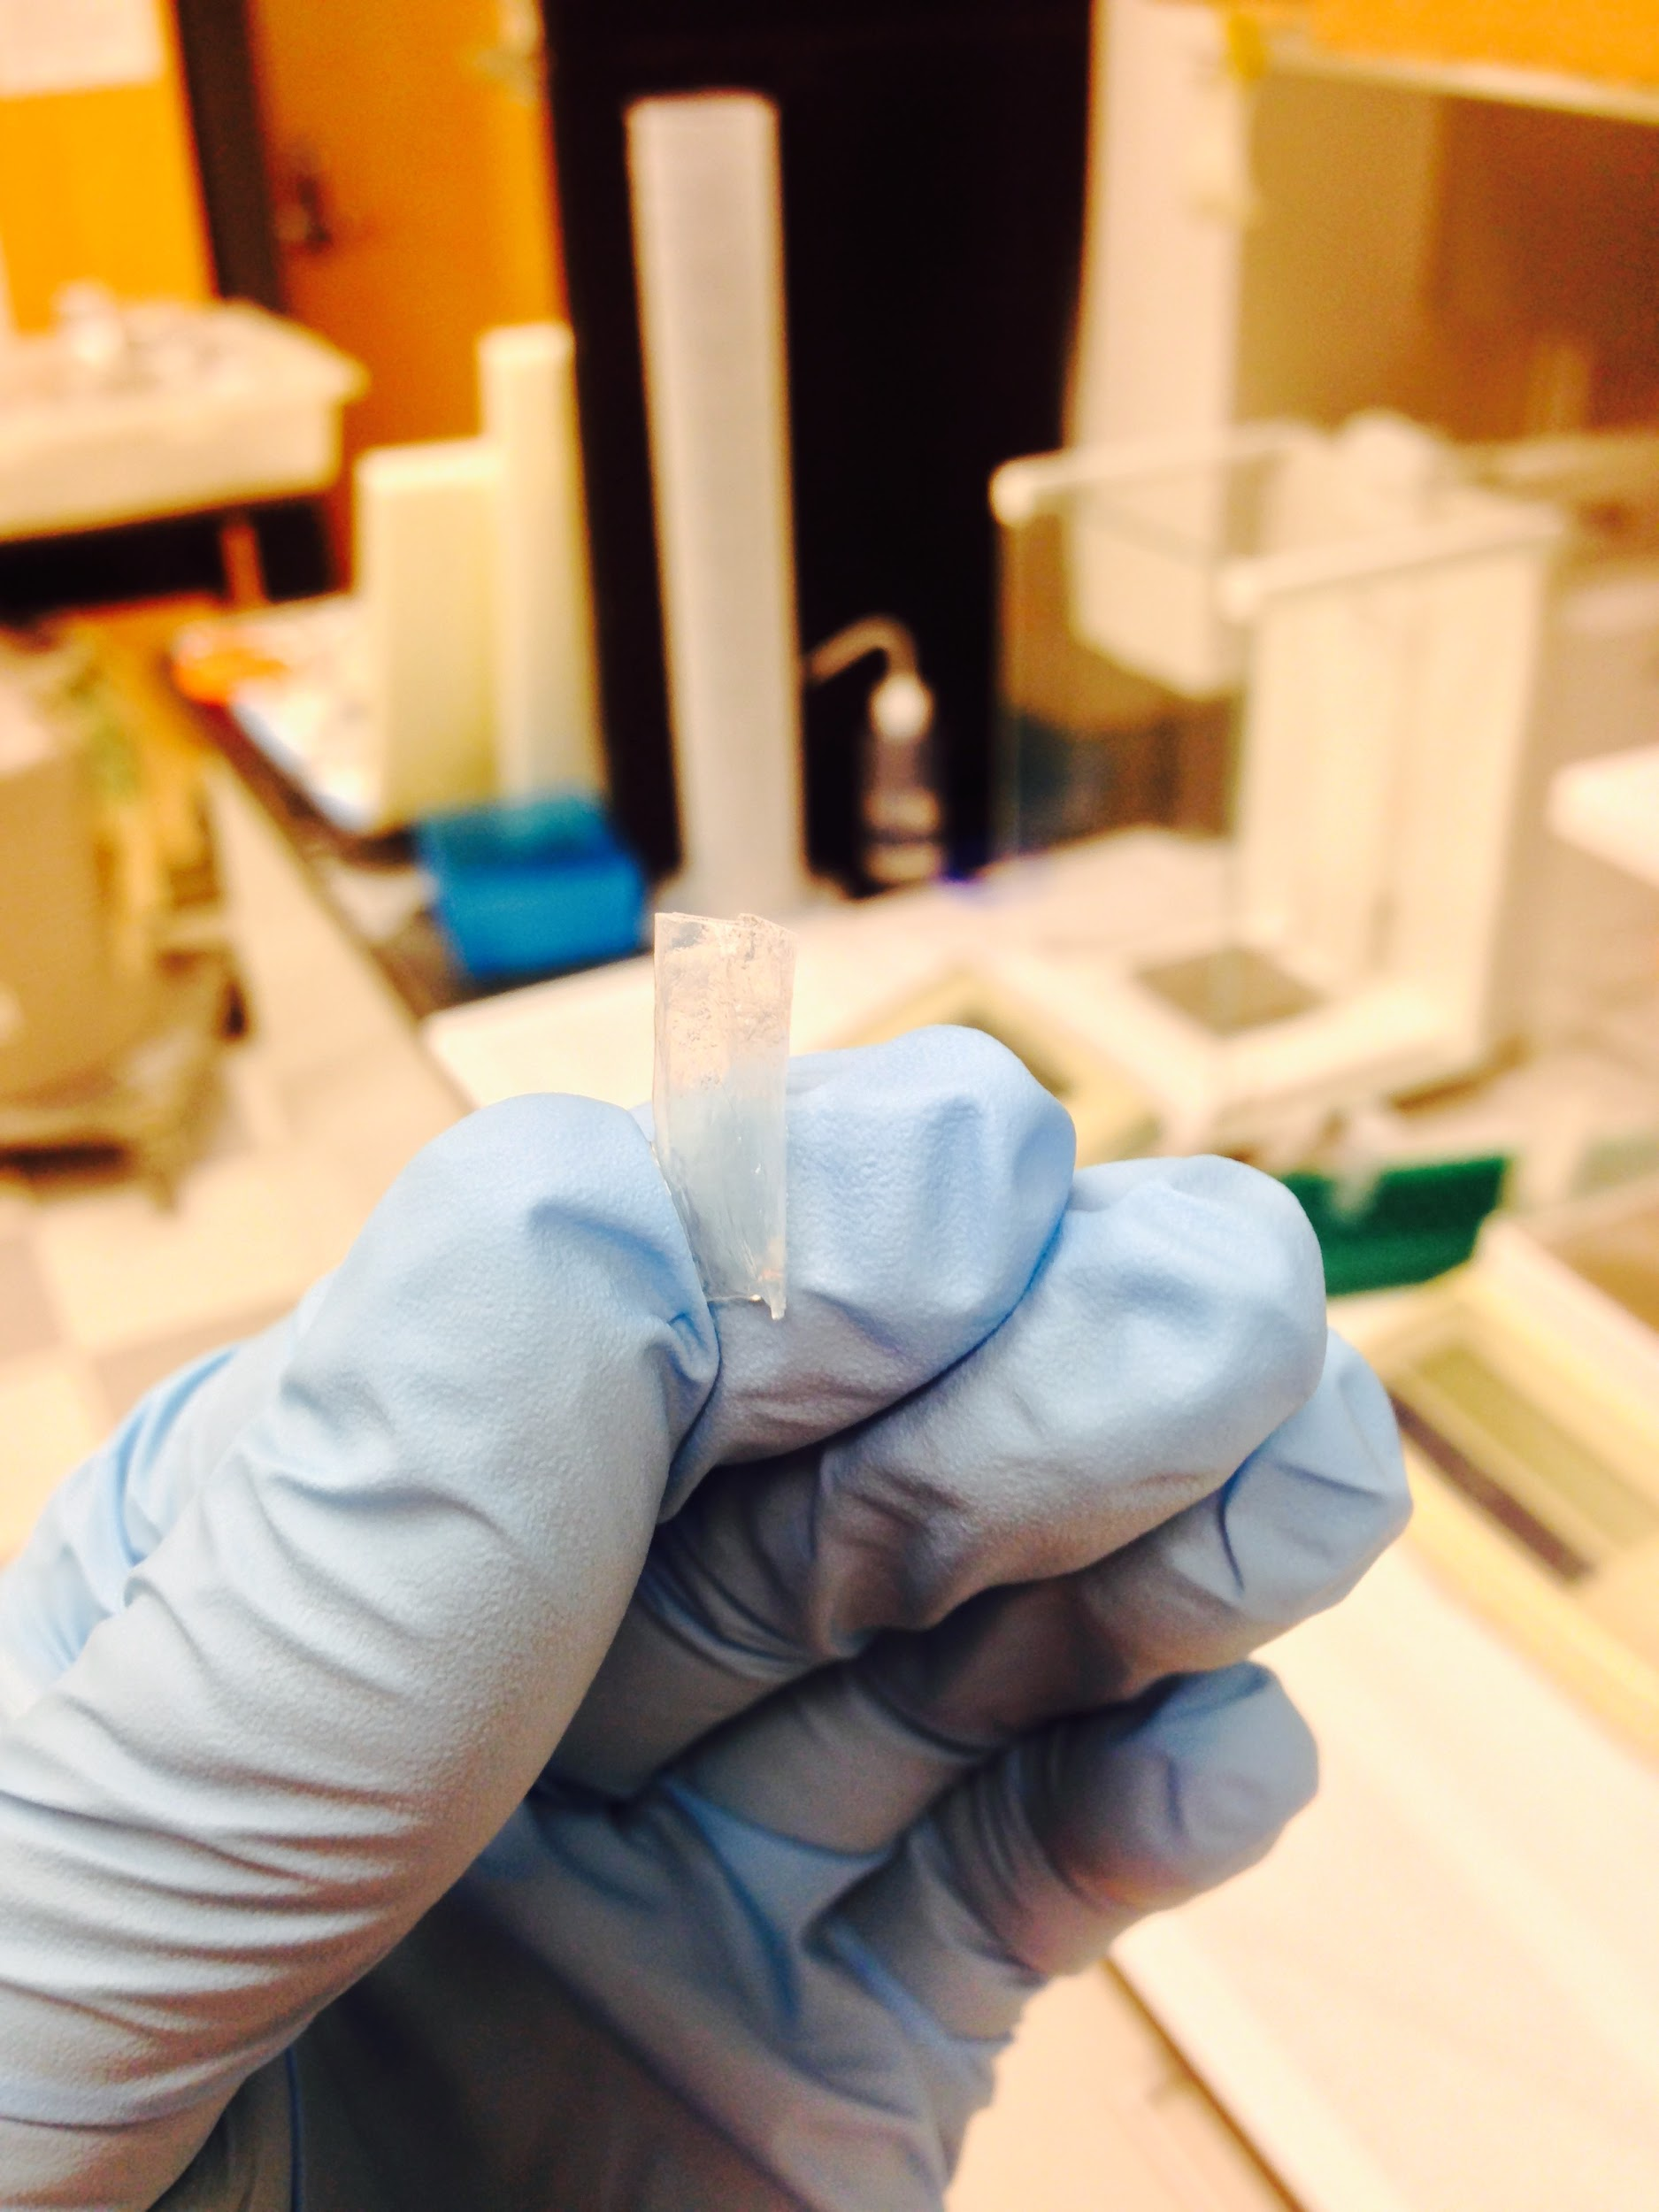
Graft Dipping
Notes:
As we wait for electrospinner, we are doing dipping method to make grafts.
Silk is concentrated and then a wire is dipped in the SF and fixed with MeOH to induce the more stable B-pleated sheets. Repeated a couple of times to make them thicker. After drying, the SF grafts are removed from the wire.

Slide 15
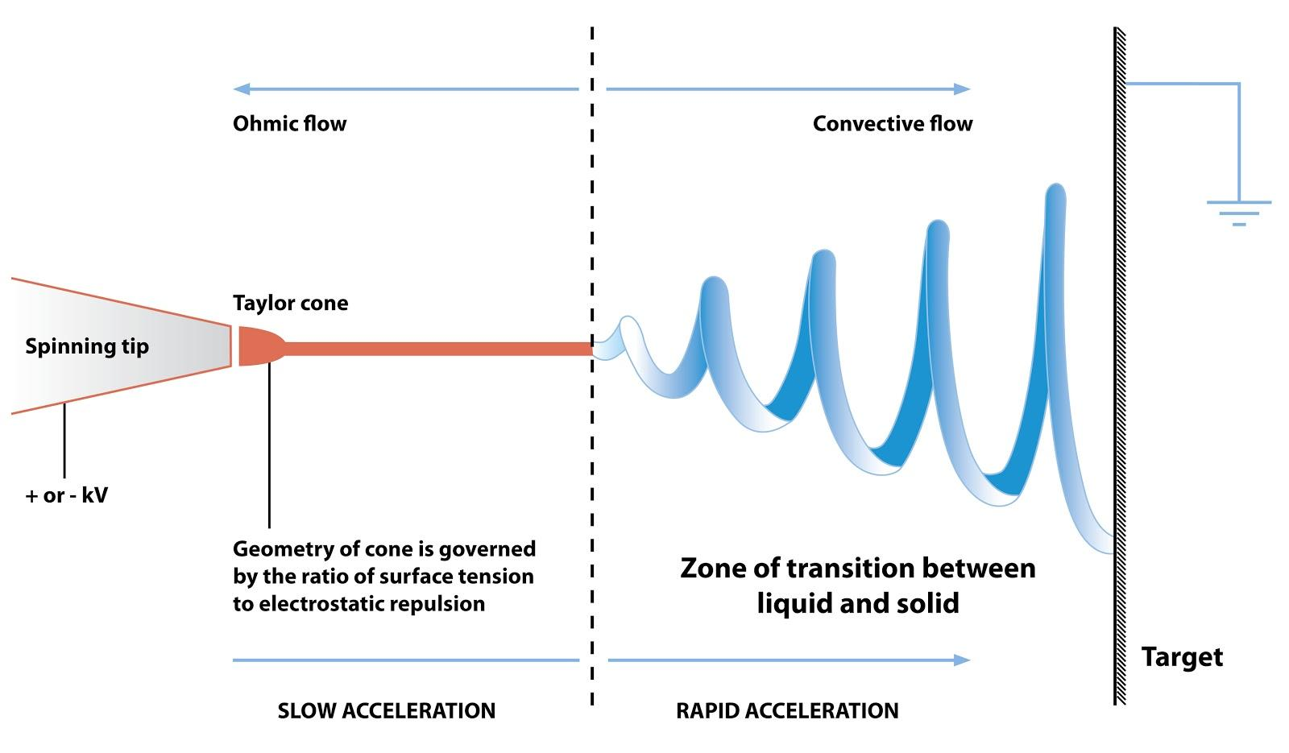
Electrospinning
Electrospinning will be used to fabricate silk fibroin solution into sheets or tubes
http://upload.wikimedia.org/wikipedia/commons/c/ca/Electrospinning_Diagram.jpg
Notes:
Irene
reference pictures
What electrospinning does
using a syringe full of our aqueous solution, an oppositely charged plate pulls the solution out in long fibers that are woven onto a drum and can create many different types of vessels depending on how the fibers are aligned
Why electrospinning
Versatile electrostatic fiber fabrication
Notable applications for tissue engineering
Advantage
Simple
Exceptional aspect ratio and uniformity
Diversity in composition/materials
First, we will need to create a solution of 28% SF w/v and stir for 10 minutes at 4 degrees Celsius.
10 milliliters of solution will be collected and placed into a syringe mounted on a syringe pump and pointed at the collector plate 7 - 20 centimeters from the tip of the needle of the syringe
After electrospinning, the fibers will be collected and immersed in a 90% vol/vol methanol/water solvent for 20 minutes and dried in a chemical fume hood.

Slide 16
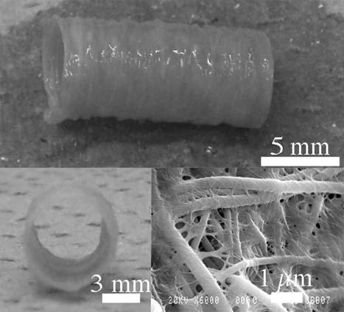
Possible Graft Modifications
Coatings
Fibrinogen
Heparin
Elastin
Growth Factors
Vascular Endothelial Growth Factor (VEGF)
Epidermal Growth Factor (EGF)
http://onlinelibrary.wiley.com/doi/10.1002/mabi.201200195/abstract
From Marelli et al., 2012
Notes:
start out with basic SF graft with a diameter of 6mm
problem:
-a graft of of a small diameter is susceptible to occlusion due the clotting and hyperplasia (too much cell growth)
-silk fibroin also becomes brittle, so elasticity and flexibility needs to be increased
modifications: coatings and growth factors
-fibrinogen: promotes cell adhesion and proliferation
-heparin: anticoagulant, which would aid in the problems with blood clots
-elastin: because the silk fibroin grafts typically become brittle, they need more elasticity and flexibility
-growth factors: later on in timeline b/c it considers the growth of cells on grafts and we might not have time to seed the grafts
Graft modification is an important part of the vascular graft creation process, because small diameter grafts are susceptible to occlusion due to clotting and hyperplasia. Additionally, SF also becomes brittle in the methanol during the extraction process, so elasticity and flexibility need to be increased. To do this, we will add coatings to the grafts. One of the substances we would like to add is fibrinogen, which promotes cell adhesion and proliferation on the graft. As stated before, small diameter grafts are prone to clotting and thrombogenicity. Another coating we are considering is heparin, an anti-coagulating agent, which would combat these issues. The final coating our team would like to test is elastin, which improves the flexibility and elasticity of the SF grafts.
Growth factors are modifications to the graft that help promote the growth of cells onto vascular grafts. There are two growth factors we are interested in: Vascular Endothelial Growth Factor (VEGF) and Epidermal Growth Factor (EGF). VEGF binds to two types of phosphotyrosine kinase receptors, flk-1 and flt-1 which play an important role in the growth and maturation of endothelial cells. EGF continually deposits and activates platelets. Improved graft skeletal construction via synthetic polymers or biologically derived structural proteins are bonded to bioactive cytokines and growth factors to induce a favorable host response.
Fibrinogen:
To do this, the graft is rinsed with Tris buffer, then continuously rinsed with solutions of fibrinogen for 60 minutes. Next, it is rinsed with more Tris buffer and thrombin for 10 minutes. Finally, it is rinsed with Tris buffer and fibrinogen for 2 hours.
Heparin:
To add heparin, we will add 1 gram of heparin, 2 grams of 1-ethyl-3-(3-dimethyl aminopropyl) carbodiimide, and 1.2 grams of N-hydroxysuccinimide to 500 milliliters of 0.05 M 5.6 pH 2-morpholinoethaneulfonic acid buffer for 10 minutes at 37 degrees Celsius. The grafts are then immersed into the solution for 4 hours at 37 degrees Celsius under gentle shaking. Then, the grafts are rinsed in a solution of 0.1M disodium phosphate and 4M sodium chloride 4 times for 24 hours. Finally, the grafts are distilled in water 3 times for 24 hours.
Elastin:
To add elastin to the graft, first one end of the graft must be clamped and the entire graft infused with cold 6% w/v elastin polymer solution. Then, the graft is immersed in an elastin bath at 4 degrees Celsius for 6 hours. Finally, the graft is drained, 60 milliliters of air pushed through the lumen to remove excess elastin, and oriented vertically at 37 degrees Celsius for 30 minutes.
Growth Factors:
To incorporate growth factors onto the graft, polylactide-co-glycolide is mixed with the growth factor. Then, the mixture is freeze fried at -40 degrees Celsius overnight and combined with sodium chloride. Next, the resulting mixture is combined with SF and then flattened and molded into the appropriate shape. The mixture is then subjected to carbon dioxide at high pressure and returned to standard conditions following equilibration, which allows the polymer and gas to separate, resulting in a porous polymer structure. Then, the sodium chloride is removed by submerging the polymer in distilled water. The polymer is then freeze dried at -40 degrees Celsius overnight.

Slide 17
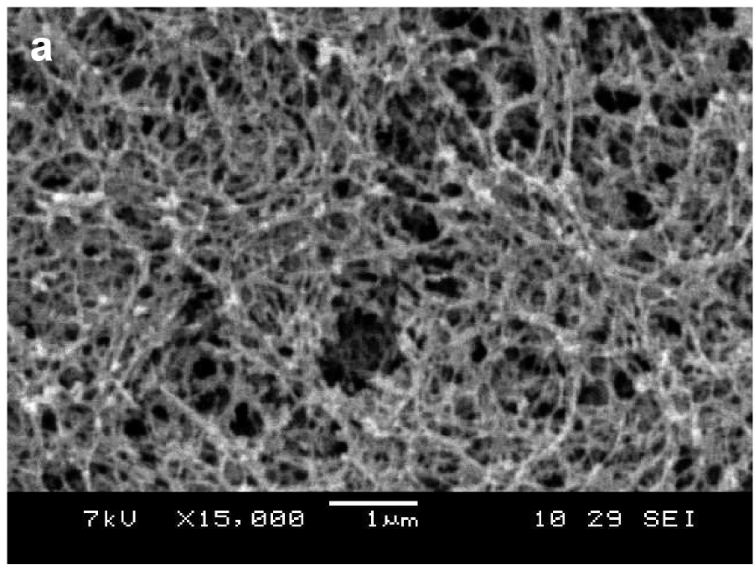
Matrigel
Mimics in vivo extracellular matrix
Basement membrane protein mix
Has been shown to have 1,851 proteins for biological processes, cellular localization, and molecular function (Hughes et al., 2010)
Commonly used in tissue engineering applications
From Gelain et al., 2006
Notes:
The whole goal is to recruit cells to the graft, giving them a good scaffold on which to grow - increase biological function to mimic the in vivo environment
Extracellular matrix proteins key to cell proliferation
If we can more accurately mimic native cell environment -> better cell growth
Picture shows SEM of matrigel
murine = mouse
Derived from a mouse sarcoma cell, which produces a lot of these basement membrane proteins
Has a lot of proteins in it that have been identified in previous studies
Key proteins in matrigel include laminins, type IV collagen, and heparin sulfate proteoglycans (important for binding VEGF and other cytokines) among many others
Regardless, all the proteins have similar roles in promoting cell growth. Aids with:
biological processes
cellular localization
and molecular function

Slide 18
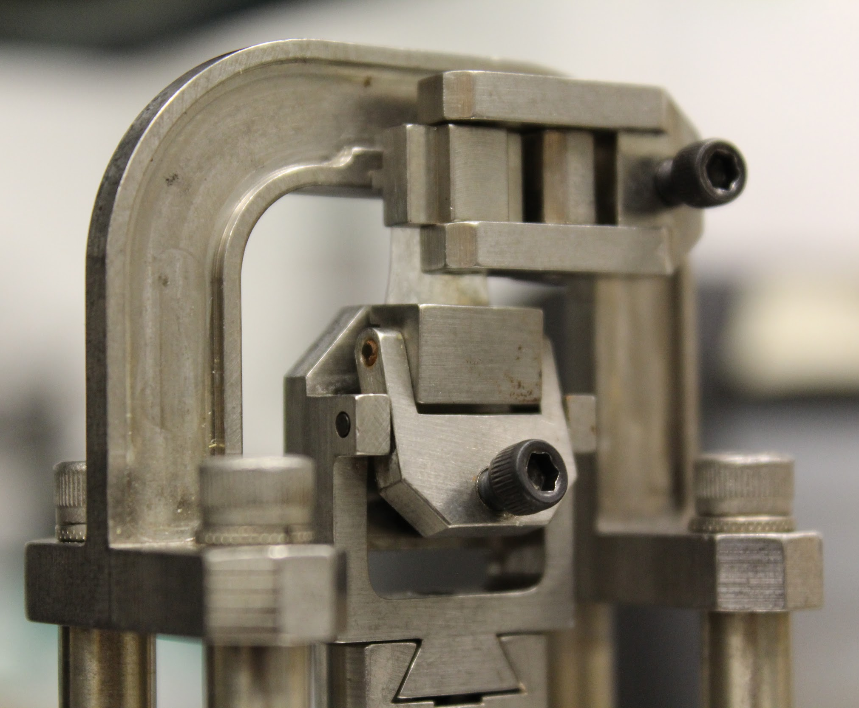
Graft Testing
Mechanical Testing
Burst Test
Tensile Test
Suture Retention Test
Notes:
-burst test evaluates how well a graft can withstand blood pressures (encyclopedia handbook of biomaterials and bioengineering
-to test this air will be pumped into submerged grafts, increasing the pressure, until the graft reaches it’s limit and bursts or shows the first sign of CO2 being released from the submerged graft
-Tensile test - measures the graft’s resistance to internal longitudinal stresses, that would occur after implantation. To test this, the graft was attached to a DMA (Dynamic Mechanical Analysis) Q800 machine and stretched over an extended period of time at a certain strain level until it tears.
-suture tensile testing will also involve the use of a DMA to stretch the graft, but in this case, one end will be attached to a suture to see at what force the graft can no longer retain it.
photos of tensile, video of burst

Slide 19
Graft Testing
Biological Testing
Live/Dead Stain
MTT Assay
Degradation Properties

Slide 20
Current Progress
Silk preparation
Tubular structure
Electrospinning mandrel
Electrospinning technique
Tensile testing technique
Burst pressure testing technique

Slide 21
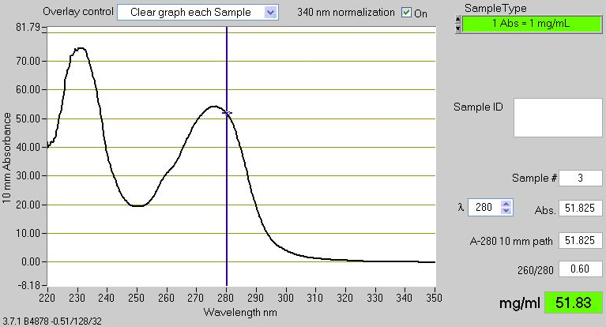
Silk Fibroin Sample Data
Notes:
Section 3: Presenting Current Data, Future Directions, Etc. (Marquise) [slides 21-end]
For each batch of silk, Nanodrop Ultraviolet-Visible spectroscopy was used to measure the concentration and purity of the silk fibroin. This is performed for quality control. The image above shows a representative spectrum. Each batch is approximately 7-8% w/v silk fibroin; this is then concentrated to about 15-16% which is needed for dipping and electrospinning. As shown above, the relative nucleic acid to protein absorbance was taken and found to be within range of the literature value of 0.60 or less.
For each batch of silk, use Nanodrop UV-Vis spectroscopy to measure the approximate concentration and purity of the SF.
Each batch approx. 20 mL of 7-8% SF
Concentration to ~15-16% to allow dipping and electrospinning easier (increased viscosity)
A260/A280 measures relative nucleic acid (absorbs at 260 nm) to proteins (absorb at 280 nm). Value of 0.60 or less is good.
Concentration automatically generated from nanodrop - this is a 1:2 dilution with water so actual protein conc. is ~15.6 mg/mL

Slide 22
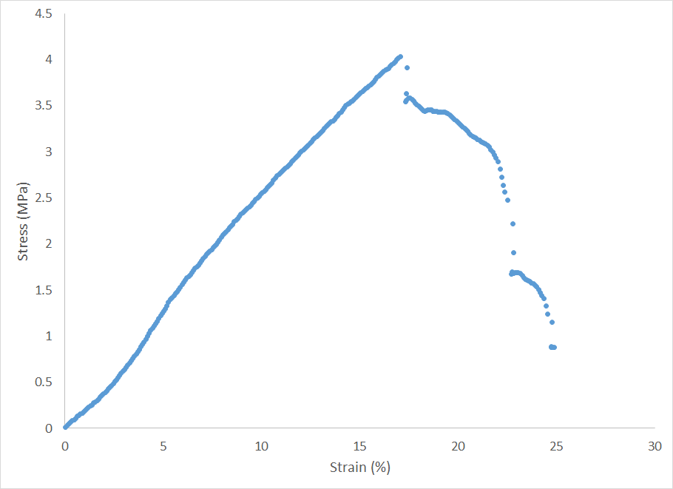
Preliminary Mechanical Data
Notes:
In addition to solidifying our method for preparing the graft, we have begun testing the mechanical strength of the graft. In the image above, a stress-strain curve is shown using the DMA Q800. For this particular tensile test, the rate was 2.5% strain per minute the ranged from 0 to 25% strain. Failing at about 17% strain. While this result is comparable to the literature, many more replicates must be tested.
We have begun our initial testing of our silk fibroin grafts, to determine the control tensile strength
The results we receive from the DMA Q800 show a stress-strain curve (x-axis = strain and y-axis = stress)
For the Tensile Test, we set a strain rate (% strain per minute) for a set amount of strain to pull our sample at
This graph represents one of the first tests we performed on our dipped grafts. The graft we used had been tested at slower and more gradual rates before being tested at 2.5% strain/min to 25% strain.
As you can see from the graph, our graft failed at around 17% strain (where the graph abruptly stops increasing at its initial steady pace), which was possibly due to the previous testing we had done to the same graft
To confirm this, we must continue our testing until we get consistent results for every graft we test

Slide 23
Goals: Moving Forward
In vitro testing with and without Matrigel
Electrospinning on mandrel
Perfect the control graft mechanically
  Suture rip and burst pressure tests
Test other growth factors and coatings
Team shirts
Notes:
Can we combine long term and short term goals into Goals Moving Forward?

Slide 24
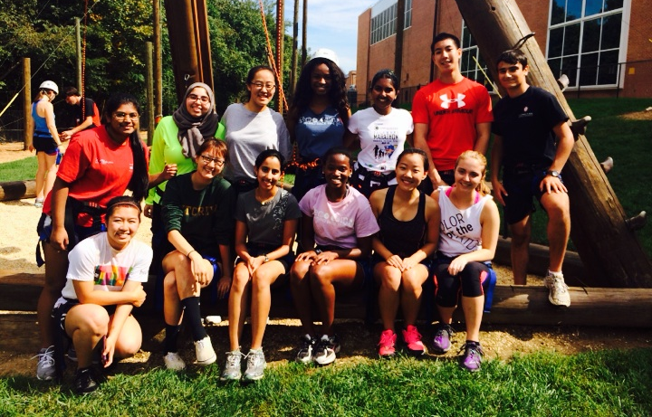
Challenges
Coordinating meetings and lab work
Meeting balance
Subteams
Accountability
Notes:
Outside of regular meeting times
Making sure everyone has a voice
Balancing discussion on what has been done and what needs to be done

Slide 25
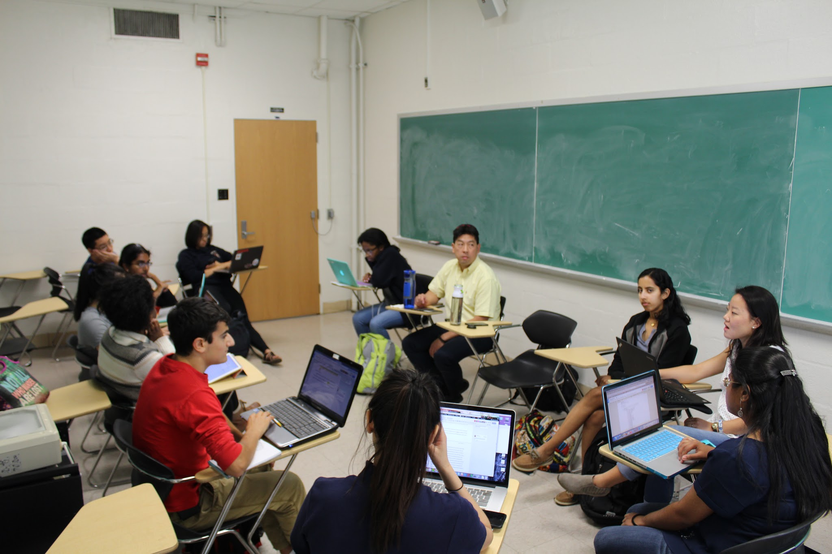
Advice for Future Teams
Communication is key
Stay up to date
Enjoy the process
Notes:
Sub-bullet points
Both in person and through technology
Research doesn’t stop, so stay up-to-date
Have bonding activities
The process is worth more than the outcome
Freshmen are very worried about who’s on their team and the team dynamics
Having a long term goal in mind, big picture of how Gemstone research affects your college/life experience
Enjoy the process
Everything is troubleshooting
"Challenge by choice"

Slide 26
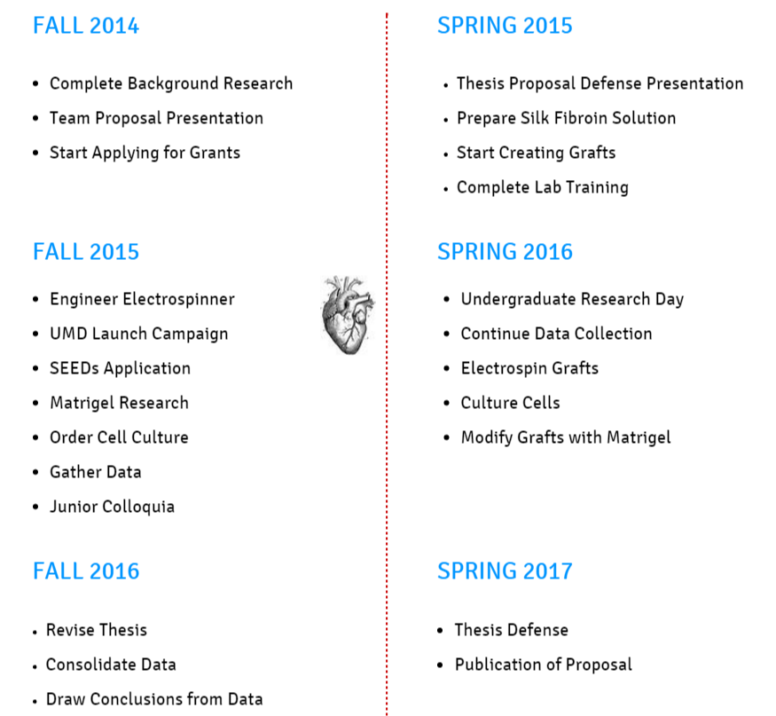
Timeline
Fall 2015 to Spring 2017
Notes:
Spring 2015 - grants and start making control graft ( no dipping)
Add:
Fall 2014
-Grant Application
-Silk Fibroin Preparation
-Electrospin Control Grafts
Spring 2015
-Modify Grafts
-Test Grafts Mechanically and Biologically

Slide 27
Conclusions
Clinical need for viable synthetic small diameter vascular graft
We have successfully created tubular small-diameter SF vascular grafts
Currently attempting to make electrospinning work to better tune structural properties
Other coatings and growth factors may improve mechanical and biological performance of grafts
Notes:
do you want me to sum up the methodology in this section too?/ allude to the basic plan of the project
FIX CONCLUSION

Slide 28
Our Support System
Mentor
  Dr. Adam Hsieh
Collaborations:
  Dr. Peter Kofinas and Mert Vural: Tensile testing
  Dr. Liangbing Hu: Electrospinner
  Dr. David Kaplan (Tufts U): Silkworms and consult
  Justin Opfermann: Burst pressure test
  Jay Research Group: HUVECs
  OML Lab Staff
Advisors
  Dr. Steven Jay
  Dr. John P. Fisher
Librarian
  Eileen Harrington
  Gemstone Staff
Notes:
This can be a Thank You slide at the end?

Slide 29
References
Annual Book of ASTM Standards. (2012) (Vol. 13.01).
Bhardwaj, N., & Kundu, S. C. (2010). Electrospinning: A fascinating fiber fabrication technique. Biotechnology Advances, 28(3), 325–347. doi:10.1016/j.biotechadv.2010.01.004
Hoerstrup, S. P., Zünd, G., Sodian, R., Schnell, A. M., Grünenfelder, J., & Turina, M. I. (2001). Tissue engineering of small caliber vascular grafts. European Journal of Cardio-Thoracic Surgery, 20(1), 164–169. doi:10.1016/S1010-7940(01)00706-0
Isaka, M., Nishibe, T., Okuda, Y., Saito, M., Seno, T., Yamashita, K., … Yasuda, K. (2006). Experimental study on stability of a high-porosity expanded polytetrafluoroethylene graft in dogs. Annals of Thoracic and Cardiovascular Surgery: Official Journal of the Association of Thoracic and Cardiovascular Surgeons of Asia, 12(1), 37–41.
Liu, H., Li, X., Zhou, G., Fan, H., & Fan, Y. (2011). Electrospun sulfated silk fibroin nanofibrous scaffolds for vascular tissue engineering. Biomaterials, 32(15), 3784–3793. doi:10.1016/j.biomaterials.2011.02.002
Lloyd-Jones, D., Adams, R. J., Brown, T. M., Carnethon, M., Dai, S., Simone, G. D., Wylie-Rosett, J. (2010). Heart Disease and Stroke Statistics—2010 Update A Report From the American Heart Association. Circulation, 121(7), e46–e215. doi:10.1161/CIRCULATIONAHA.109.192667
McKenna, K. A., Hinds, M. T., Sarao, R. C., Wu, P.-C., Maslen, C. L., Glanville, R. W., … Gregory, K. W. (2012). Mechanical property characterization of electrospun recombinant human tropoelastin for vascular graft biomaterials. Acta Biomaterialia, 8(1), 225–233. doi:10.1016/j.actbio.2011.08.001
Sell, S. A., McClure, M. J., Garg, K., Wolfe, P. S., & Bowlin, G. L. (2009). Electrospinning of collagen/biopolymers for regenerative medicine and cardiovascular tissue engineering. Advanced Drug Delivery Reviews, 61(12), 1007–1019. doi:10.1016/j.addr.200
Vara, D.S., Salacinski, H.J., Kanna, R.Y., Bordenave, L., Hamilton, G., & Seifalian, A.M. (2005). Cardiovascular tissue engineering: state of the art. Pathologie Biologie, 53(10), 599-­612.

Slide 30
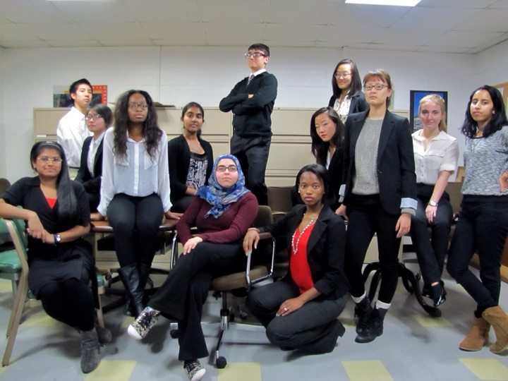
Questions?

